Slide 1
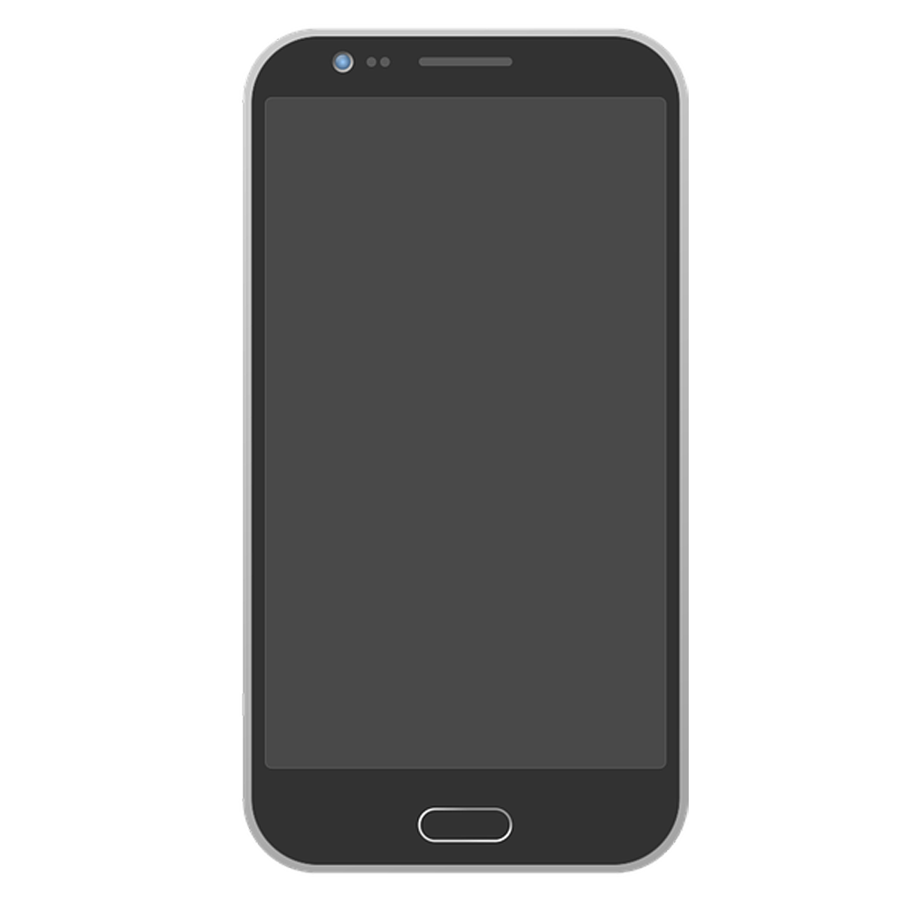
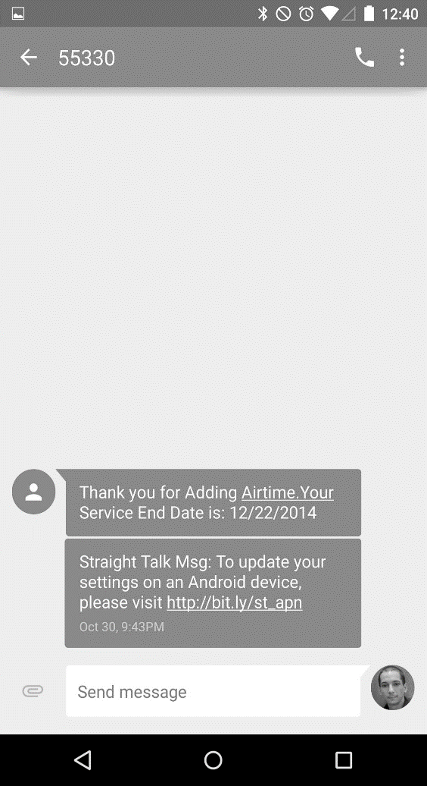

Emoji Checker
Emoji Checker
Log In
Avneet Sethi, Riyan Imam,
Michael Wheeler, Jocelyn Lopez,
Storm Simpson
Sign Up

Slide 2
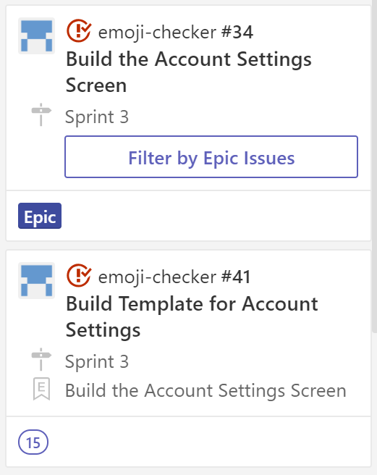
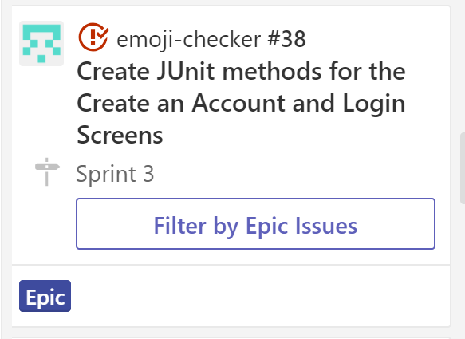
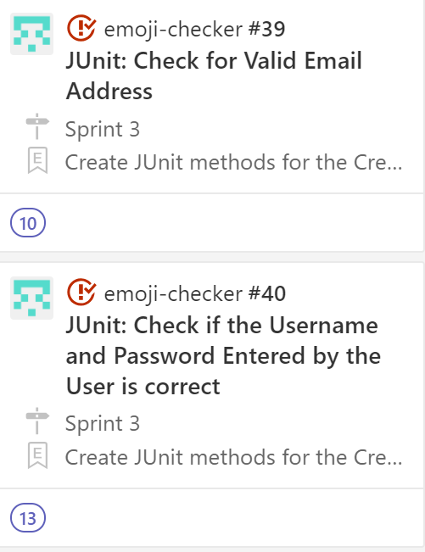
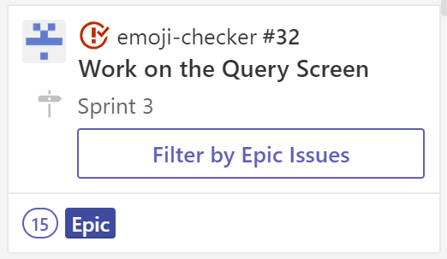
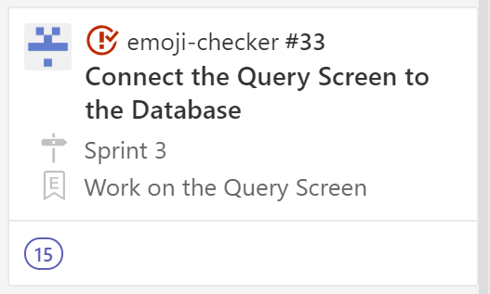
The Story So Far …
Completed Story Cards
JUnit for create an account screen, email, username and password validation
Connect the query screen for a specific user to the database
Build the layout of the account settings screen
Risks
Integrating JUnit Testing

Slide 3
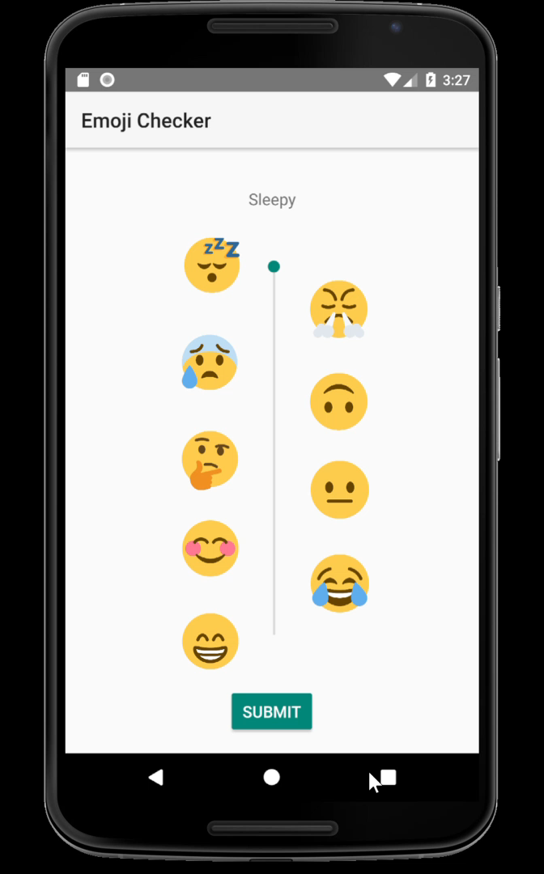
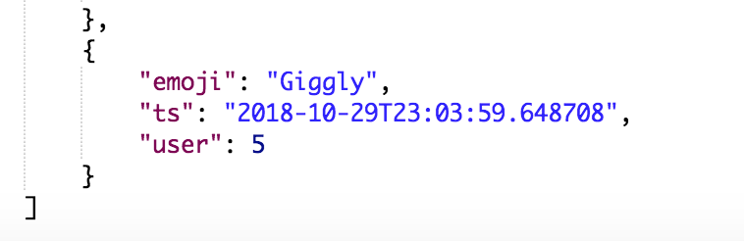
The Story So Far …
Shout-out to the back-end team, especially Sam and Perry for helping us make this happen!

Slide 4
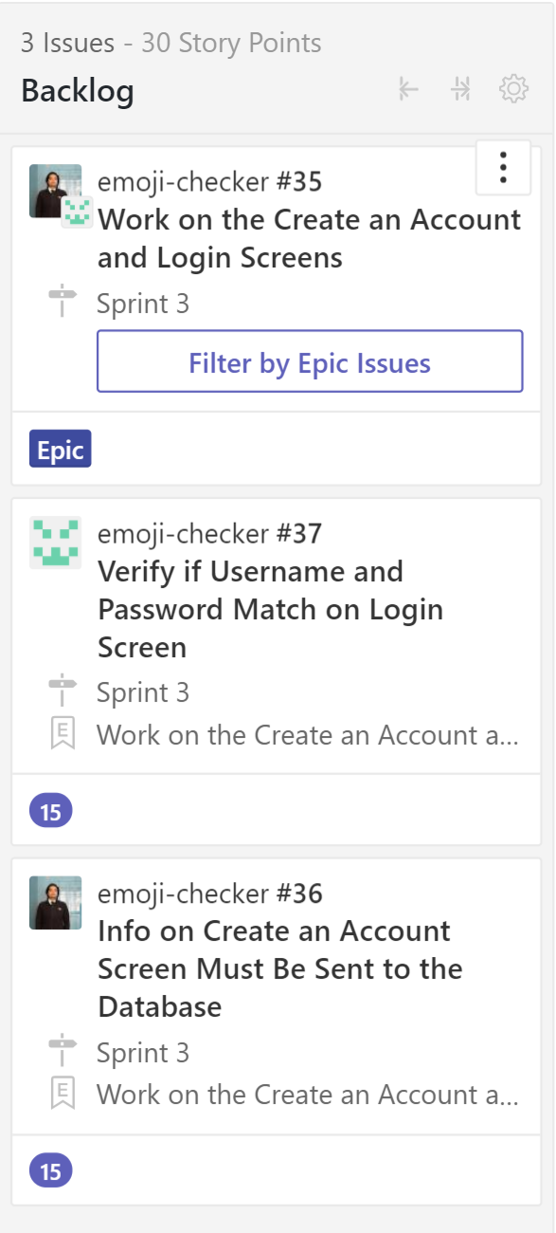
Backlog
Connecting the Registration and Login screens to the database
Upon registration, the user’s information must be sent to the database via HTTP Post request (Name, Phone Number, Birth Date)
On the login screen, we have to verify that the username and passwords match based on the registration data
We have to generate an authorization token for each user so that they can query.

Slide 5
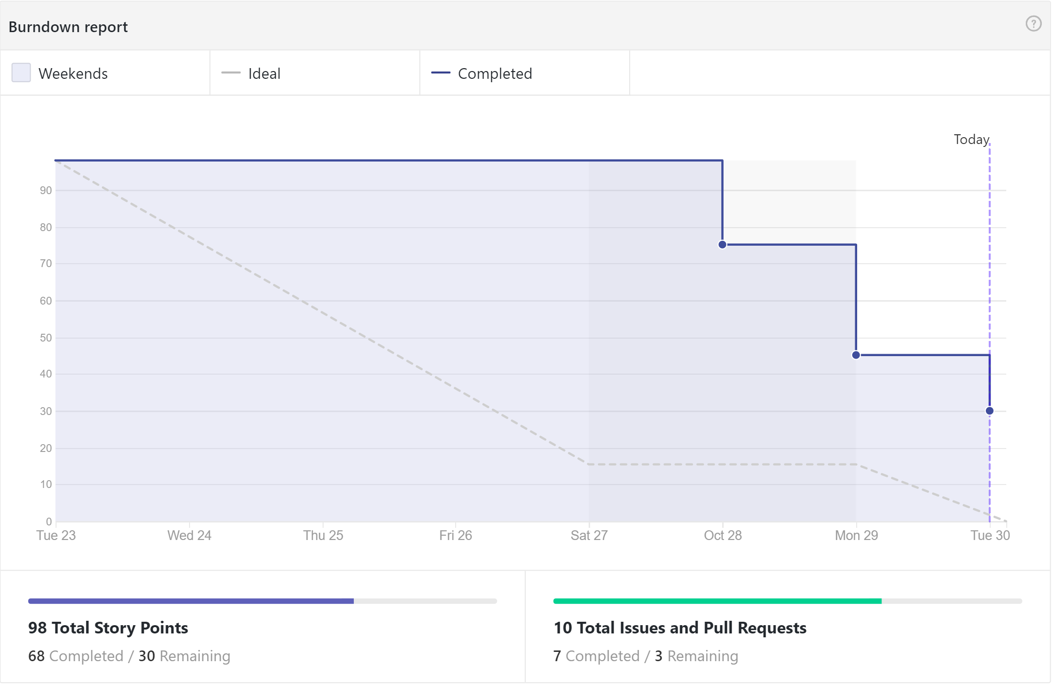

Slide 6
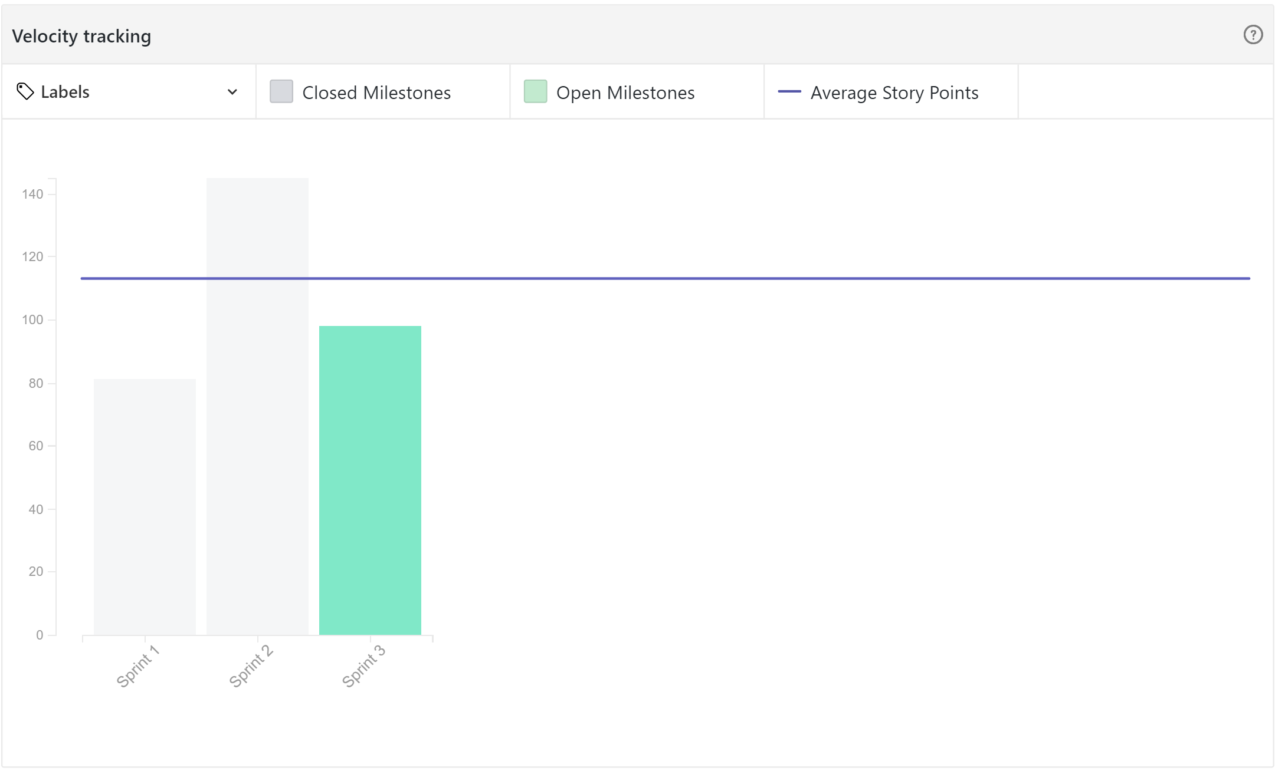

Slide 7
Facade Design Patterns

Slide 8

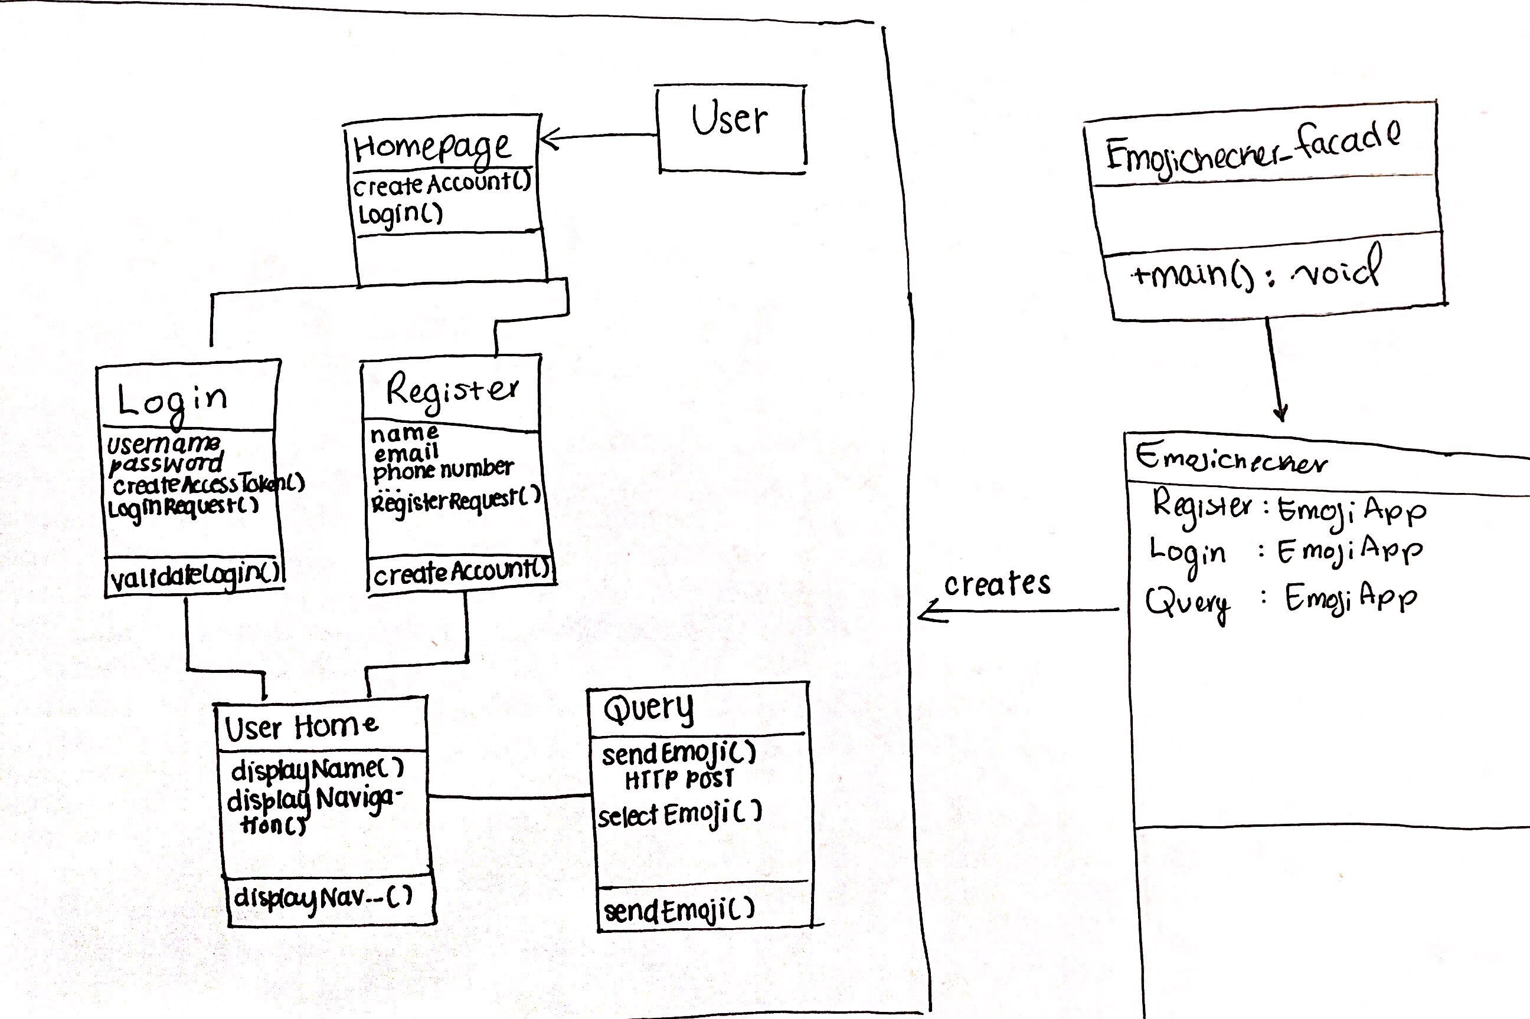
Facade Pattern

Slide 9

Plans for Sprint 4
Connect the Login, Registration, and Account Settings screens to the database
Enable query response for all users by using their respective authorization tokens
Create the View Previous Emojis screen
HTTP Get Request
Will require parsing the data from the database to display the data
Maintain the user flow between app screens

